Slide 1


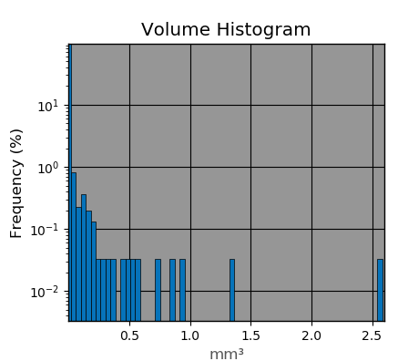
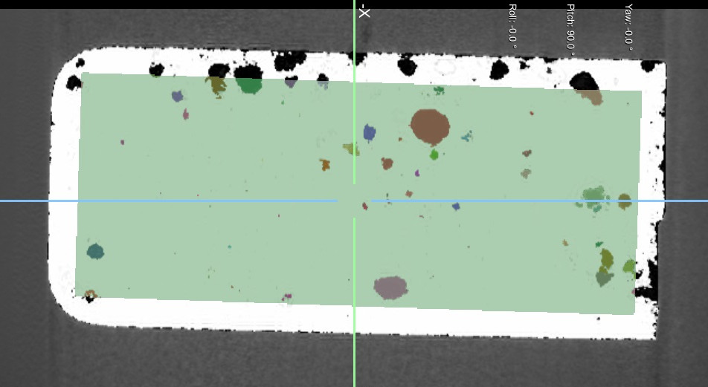
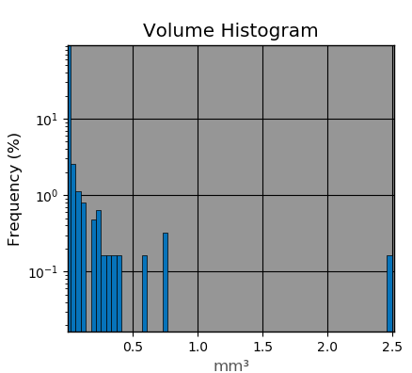
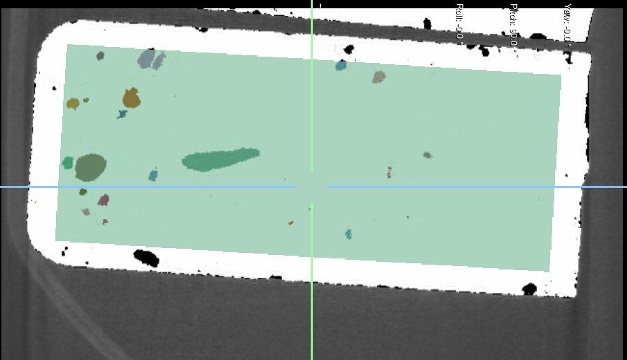
K. N. Toosi
University of Technology
Ph.D Seminar 2
Pore Volume Distribution in Bone Cement Specimens with Different Amounts of Added Antibiotics
Mahsa Alimohammadi¹, Hassan Mirzabozorg¹, Farzam Farahmand², Heidi-Lynn Ploeg³
¹KN Toosi University of Technology, Tehran, Iran, ²Sharif University of Technology, Tehran, Iran, ³Queen’s University, Kingston, ON, Canada.
Abstract
Total hip replacement (THR) is one of the most common orthopaedic surgeries. The THR prostheses are loaded repetitively in daily activities, e.g., walking, which can limit their service life by provoking fatigue damage. In particular, the cement mantel, which provides a mechanical interlock between the implant and bone in cemented THR systems, is vulnerable to crack accumulation and fatigue. The resulting aseptic loosening is considered as a main mechanism of failure of cemented THR [1,2]. An experimental study was performed to investigate the pore distribution in four groups of bone cement specimens, containing different amounts of added antibiotic. The pores were mainly of volumes less the 0.4 mm³. However, there were also a very limited number of pores with large sizes, up to about 3.0 mm³. These preliminary results indicated that analysis of the μ-CT images of bone cement specimens using advanced image processing techniques can quantify the volume distribution of pores within bone cement.
(a)
(b)
Introduction
Bone cement fracture is a main cause of aseptic loosening and subsequent clinical failure of cemented arthroplasty systems [1,2]. The strength of the bone cement against fatigue fracture is largely affected by the voids and pores which are formed during the cement preparation and setting processes. Pores are also left in bone cement with added antibiotic after elution of the antibiotic. It has been shown that these defects contribute into the crack initiation and propagation within the cement bulk [2], and hence, have a detrimental effect on its fatigue life [3].
Several studies have investigated the number, size and volume percentage of the micro- and/or macro-pores inside the bone cement specimens, using a variety of techniques. Wang et al. [4] took radiographs from cement specimens, prepared with different vacuum levels and mixing methods, and found the number, diameter, and volume percentage of pores using an optical microscope. Also, Dunne et al. [5] employed optical microscopy to quantify the pores’ area and number on the fractured surfaces of bone cement specimens, prepared using different mixing methods. While such techniques only enable investigating the pore distribution on a limited number of planar surfaces, the micro-computed tomography (μ-CT) imaging provides information from the whole three-dimensional (3D) morphology of the cement specimens. Pithankuakul et al. [6] used this methodology to measure the porosity of bone cement specimens, prepared with different mixing speeds. Recently, Kim et al. [2] employed μ-CT imaging to find the porosity of bone cement specimens, containing different amounts of added antibiotic, and found results consistent with those of the water uptake approach. The objective of this study was to analyze the μ-CT images of bone cement specimens using advanced image processing techniques, in order to quantify the distribution of the pore volume for bone cement specimens with different amounts of added antibiotic.
(c)
(d)
Figure 1 .Pore volume distributions in four specimens containing 0.3 (a), 0.6 (b), 1.2 (c) and 2.4 (d) wt/wt% added antibiotic.
Discussion
This study showed that the analysis of the μ-CT images of bone cement specimens using advanced image processing techniques can quantify the volume distribution of the pores within bone cement after antibiotic elution. Such information is of great importance when investigating the fracture behavior of cement, particularly for probabilistic modeling. These results indicate an increased mean porosity with more added antibiotic; however, this effect was only significant when comparing the lowest amount of added antibiotic with the other groups.
Methods
Significance/Clinical Relevance
Four groups of bone cement (Palacos®R) specimens, containing 0.3, 0.6, 1.2 and 2.4 wt/wt% of antibiotic (telavancin; Theravance Biopharma US, Inc., CA, USA) were prepared by vacuum mixing and forming in molds. Each group consisted of seven prismatic bone cement specimens with the approximate dimensions of 22 mm length, 5 mm width and 10 mm height. The specimens were scanned using a μ-CT system (MicroXCT400, Xradia, Oberkochen, Germany), with the X-ray tube setting of 80 kV, 9 W and 100 μA, the exposure time of 0.5 s, and the frame averaging of 100. For each specimen, 400 2D-image slices were obtained with 40 mm fields of view and 38.97 μm pixel size and thickness.
The images were first preprocessed in Mimics Innovation Suite 20.0 (Materialise NV, Leuven, Belgium) and then imported into Dragonfly version 2021.1.0.977 (Object Research Systems, Montreal, Canada). Internal prismatic volumes of interest, with the mean volume of 476.70± 0.87 mm³ were defined for analysis of pore volume distribution, to exclude surface pores. For each volume of interest, the pores were first segmented automatically in Dragonfly. The segmented volumes were then examined to join the pores with single interfacial voxels manually. The porosities of the groups were compared using one way analysis of variance (α = 0.05) and the histograms of the pore volumes were depicted.
This study quantified the distribution of pore volumes in bone cement specimens with varying amounts of added antibiotics after elution. Pore volume distribution in bone cement enables computer simulation for predicting the fatigue life of bone cement in cemented arthroplasty applications. This research addresses both infection and aseptic loosening, which are together the principal reasons for revision surgery of total joint replacements.
References
[1] Hertzberg RW, Manson JA. Fatigue of engineering plastics. London: Academic Press, 1980.
[2] Kim S, Baril C, Rudraraju S, Ploeg H-L. ASME Journal of Biomechanical Engineering. 2021; Paper No: BIO-21-1110, doi: https://doi.org/10.1115/1.4051848.
[3] Hoey D, Taylor D. Acta biomaterialia. 2009;5(2):719–26.
[4] Wang J-S, Franzén H, Jonsson E, Lidgren L. Acta orthopaedica Scandinavica. 1993;64(2):143–6.
[5] Dunne N., Orr J., Mushipe M., Eveleigh R. Biomaterials. 2003;24(2):239–45.
[6] Pithankuakul K, Samranvedhya W, Visutipol B, Rojviroj S. The Journal of arthroplasty. 2014;30(5):858–63.
Results
Acknowledgements
The histograms of the pore volumes of four specimens with 0.3, 0.6, 1.2 and 2.4 wt/wt% antibiotic are shown in Figure 1. For all specimens, the pores were mainly of volumes less the 0.4 mm³. However, there were also a limited number of pores with large sizes, up to about 3.0 mm³. The mean porosities of the 0.3, 0.6, 1.2 and 2.4 wt/wt% antibiotic groups were 1.98±0.58, 2.92±0.93, 3.45±1.05, and 3.81±1.13 vol/vol%, respectively. The difference of porosity was only significant (p<0.05) between the first group and the other groups.
The first author was supported by grants from the Natural Sciences and Engineering Research Council of Canada (NSERC), the Ministry of Science, Research and Technology of Iran (MSRT) and International Society of Biomechanics (ISB).

